Slide 1
I‘ll make you laugh
COM-MP-2011-090

Slide 2
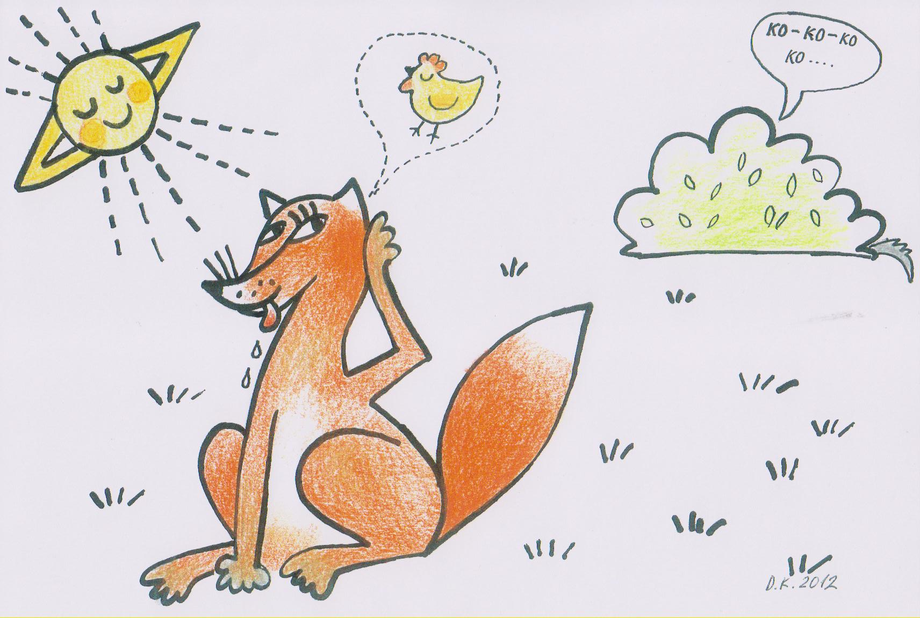
Oh, a hen would be good for lunch!

Slide 3
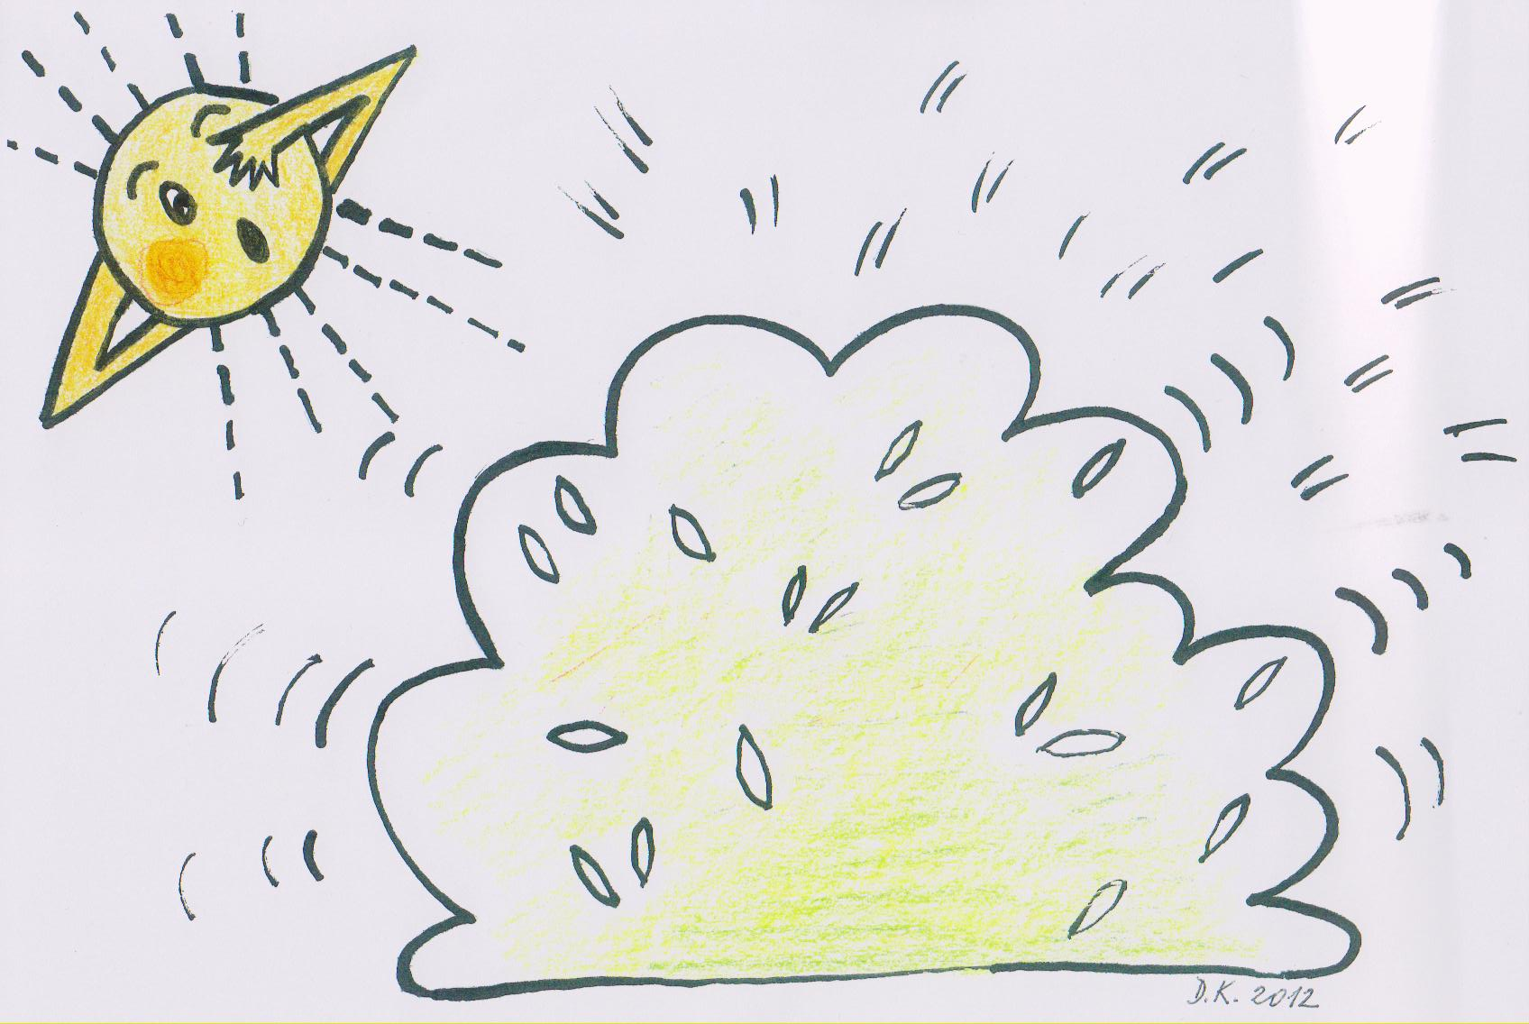
Jumped there and a fight began!

Slide 4
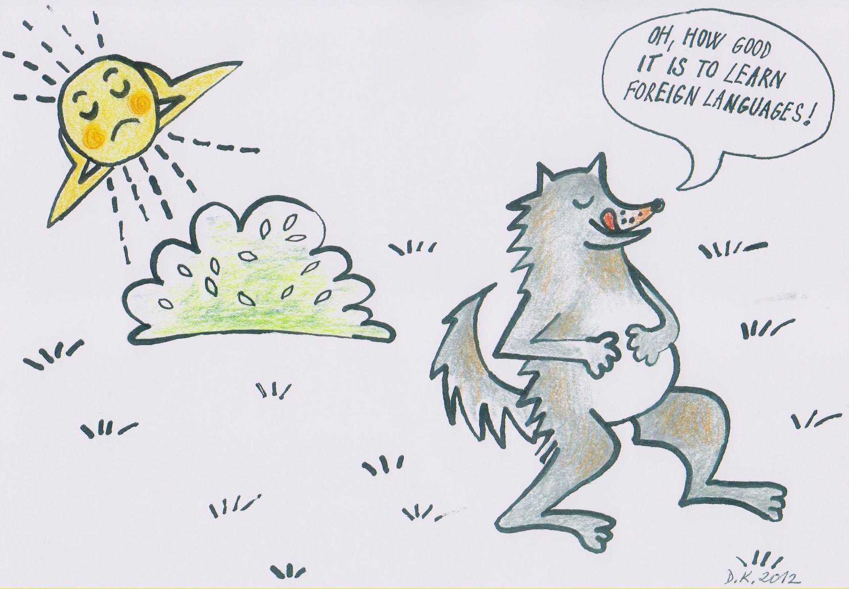
And after a while . . .

Slide 5
I‘ll make you laugh
In the beginning of 2011 a Turkish school initiated a project on jokes, and askedour school to cooperate.
But as I was not any good at telling jokes I agreed to become better! And consequently my students.

Slide 6
I‘ll make you laugh
Schools that agreed to do such a project:

Slide 7
I‘ll make you laugh
Schools that agreed to do such a project:
Mevlude Ahmet Doganay Teacher Training High School (age of students 14 – 18) YOZGAT Turkey

Slide 8
I‘ll make you laugh
The Initiator
Mevlude Ahmet Doganay Teacher Training High School (age of students 14 – 18) YOZGAT Turkey
Schools that agreed to do such a project:
Pacifici de Magistris (science, sociology, technology) (15 – 17) Italy
Zespol szkol w Lubostroniu (7-16 with soc, edu, eco, geo, difficulties) Poland
SPŠ stavební Ostrava - Zábřeh

Slide 9
I‘ll make you laugh
Remaining three schools:
XXXXXXXXXXXXXXXXXXXXXXXXXXXXXXXXXXXXXXXXXXXXXXXXXXXXXXXXXXXXXXXXXXXXXXXXXXXX
Pacifici de Magistris (science, sociology, technology) (15 – 17) Italy
Zespol szkol w Lubostroniu (7-16 with soc, edu, eco, geo, difficulties) Poland
SPŠ stavební Ostrava - Zábřeh

Slide 10
I‘ll make you laugh
Basic characteristics of jokes in the Czech Republic.
70% rude.
25% rasistic.
5% normal.
Categories: policemen, politician, blonde women, Pepíček, Hurvínek and Spejbl, A Russian an American and a Czech . . . ,religion, etc.

Slide 11
I‘ll make you laugh
The Aim of the Project
Humour, cultural differences, sensitivity to issues, religion, politics, etc.
We agreed that if unappropriate jokes are said, all students will be advised what problems could arise and avoid such jokes. (e.g. A Turkish one Temel and Dursun with a fire brigade . . . Or: There happened an accident . . . etc.)

Slide 12
November 2011 – Ostrava meeting, intended as a preparatory, beginning of work ☺

Slide 13
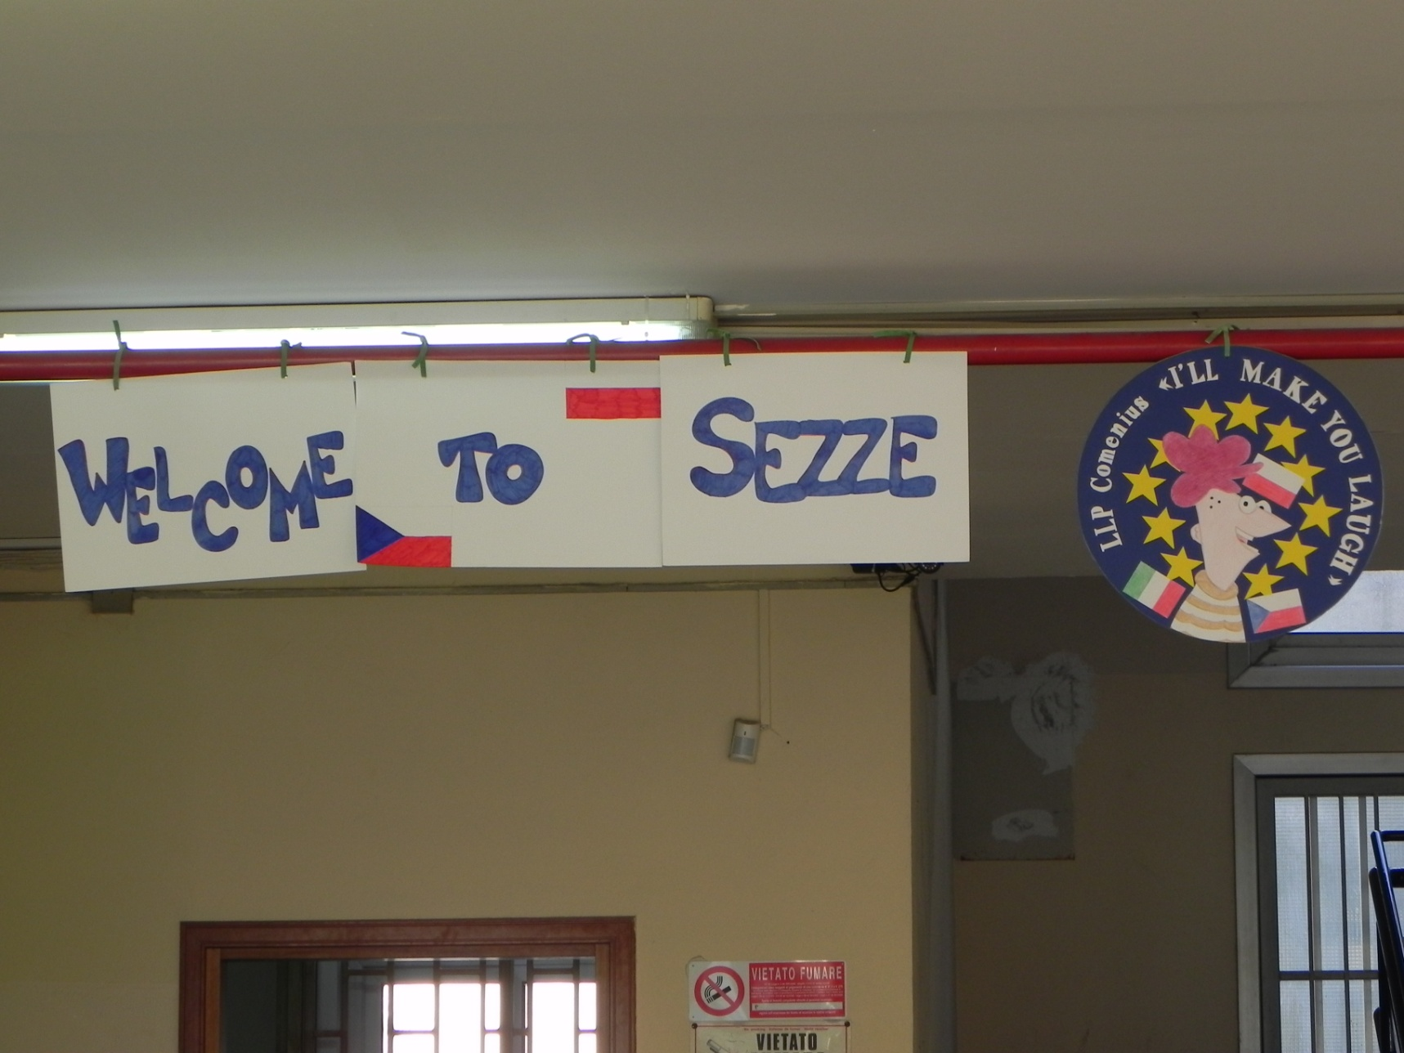
March 2012 SEZZE working meeting (9 mobilities = 7students + 2 teachers).

Slide 14
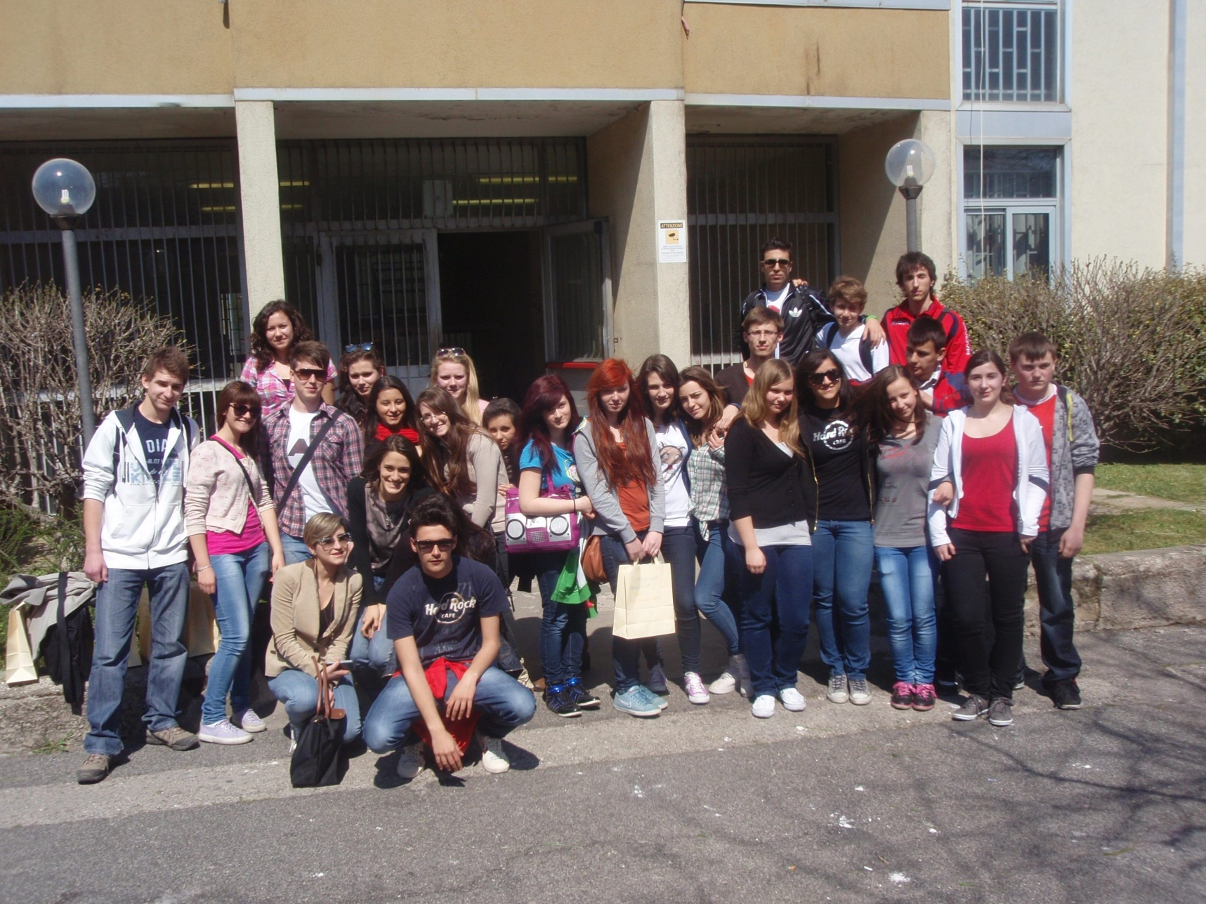
March 2012 SEZZE working meeting (9 mobilities = 7students + 2 teachers from the Cz.Rep.).

Slide 15
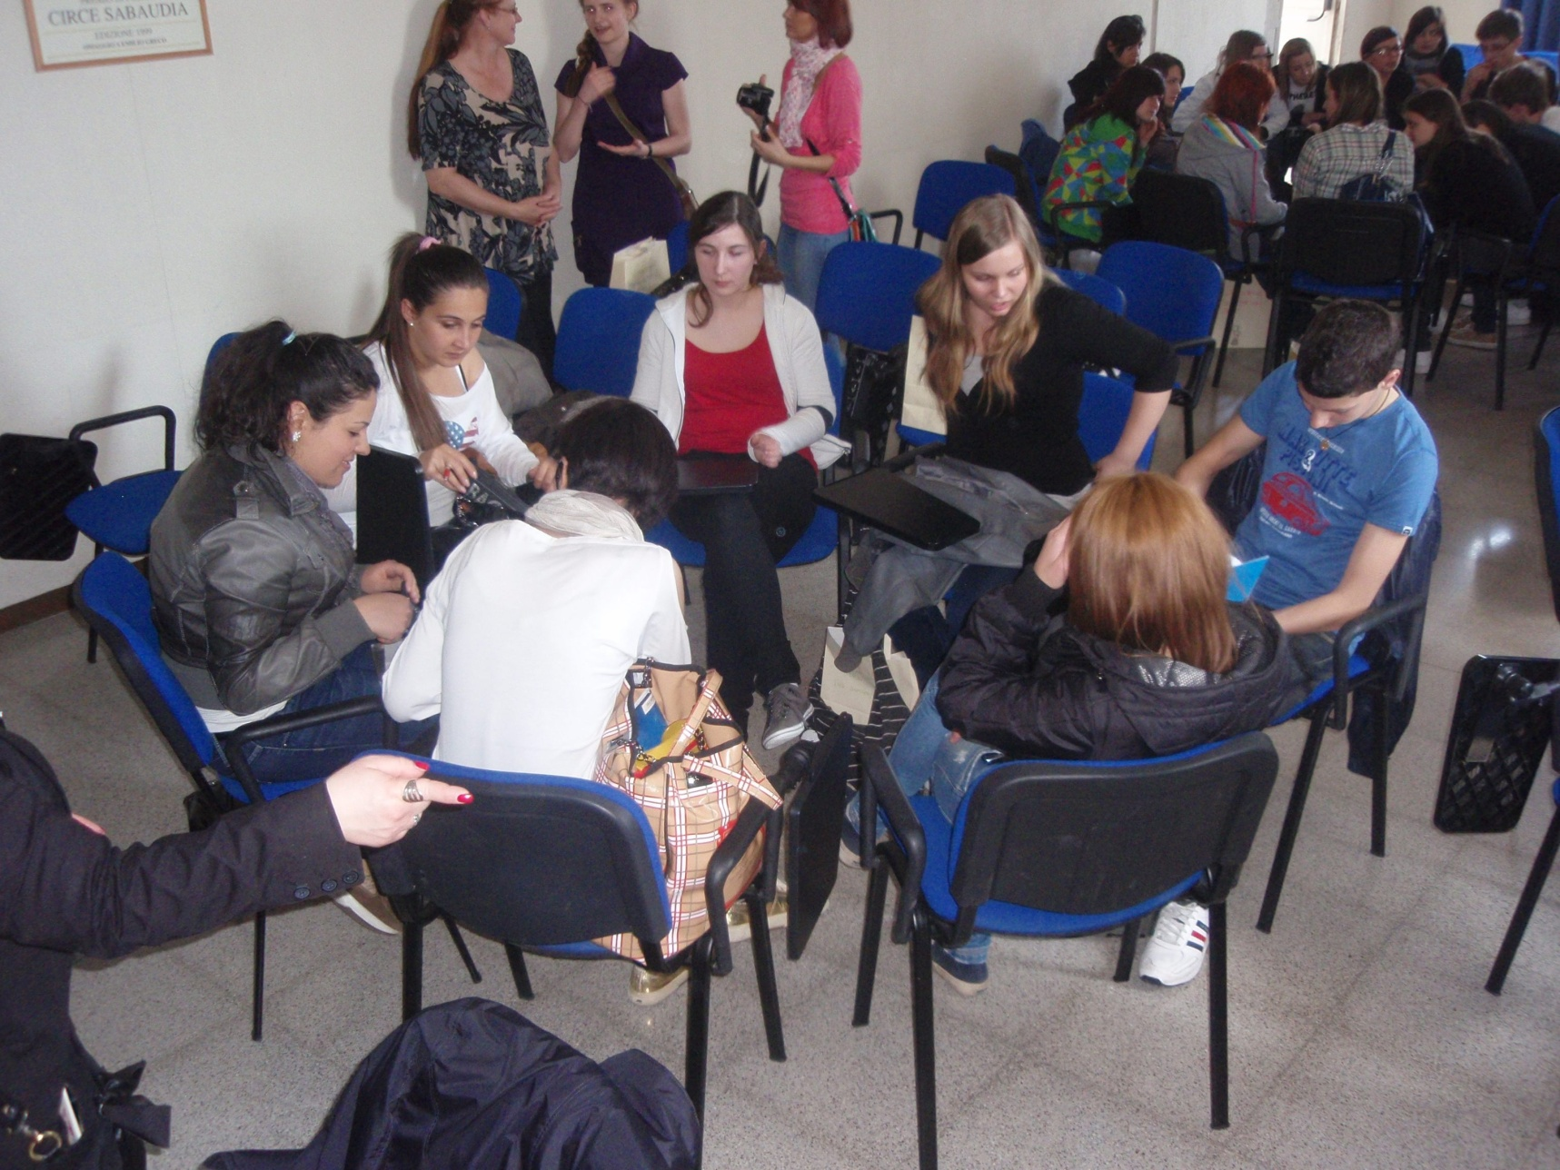
March 2012 SEZZE Jokes workshop.

Slide 16
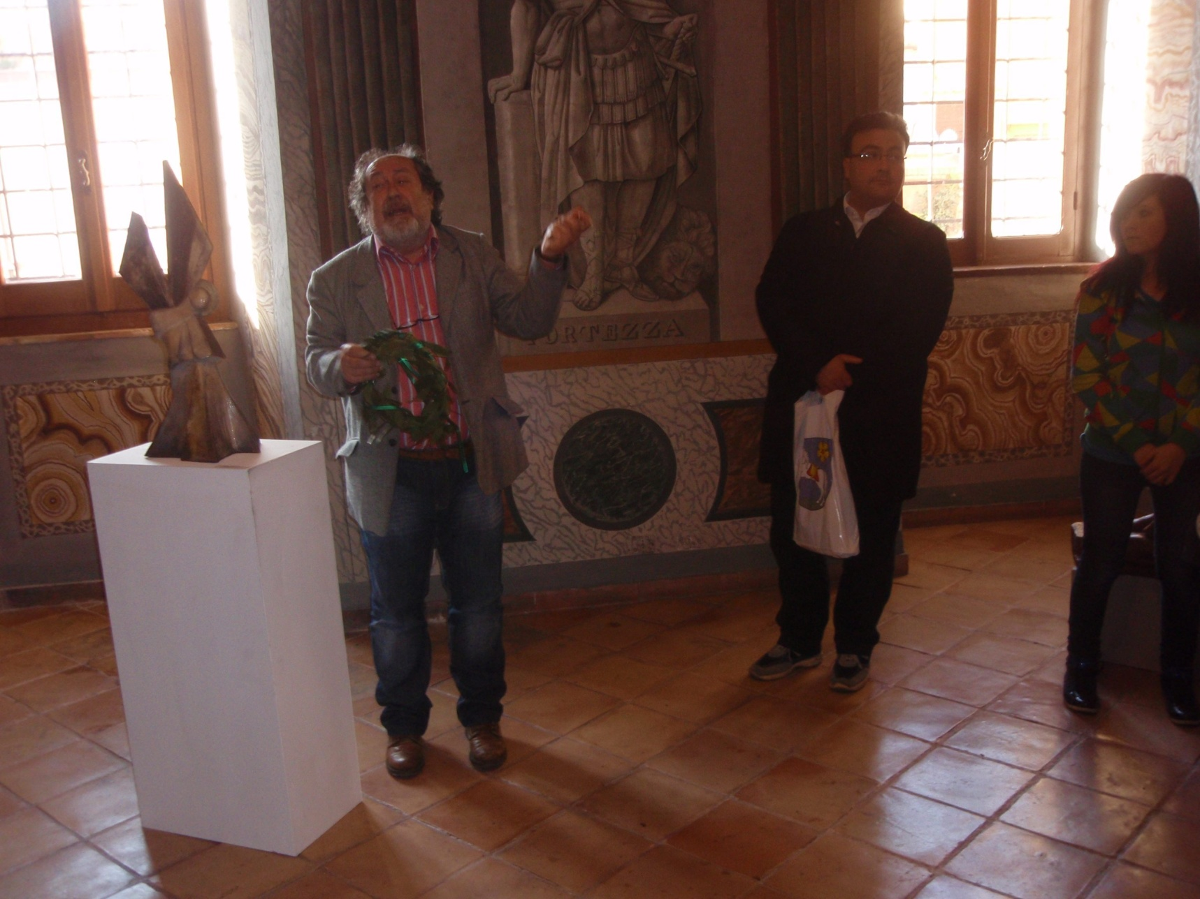
March 2012 A meeting at the Sezze town hall, a local poet and the mayor.

Slide 17
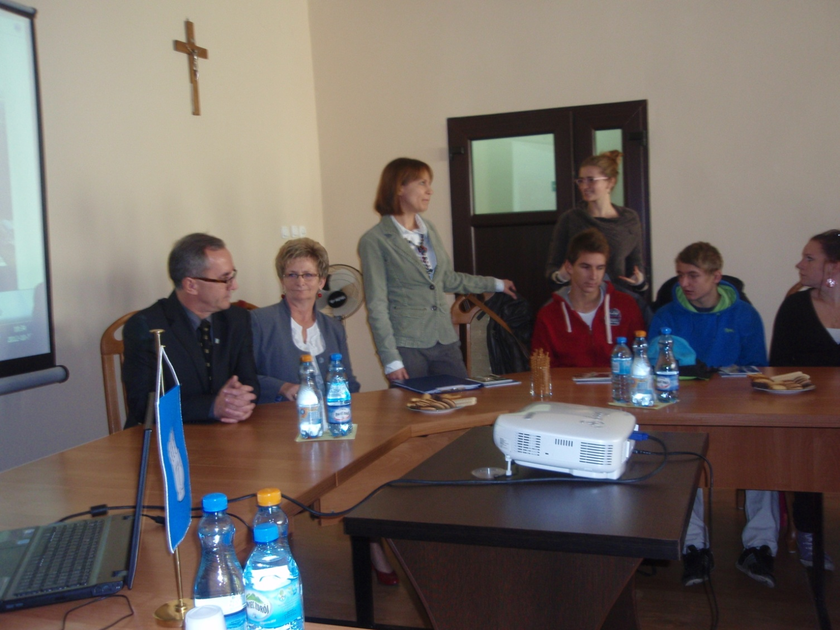
Poland, Labishin, October 2012 A meeting in Labishin townhall

Slide 18
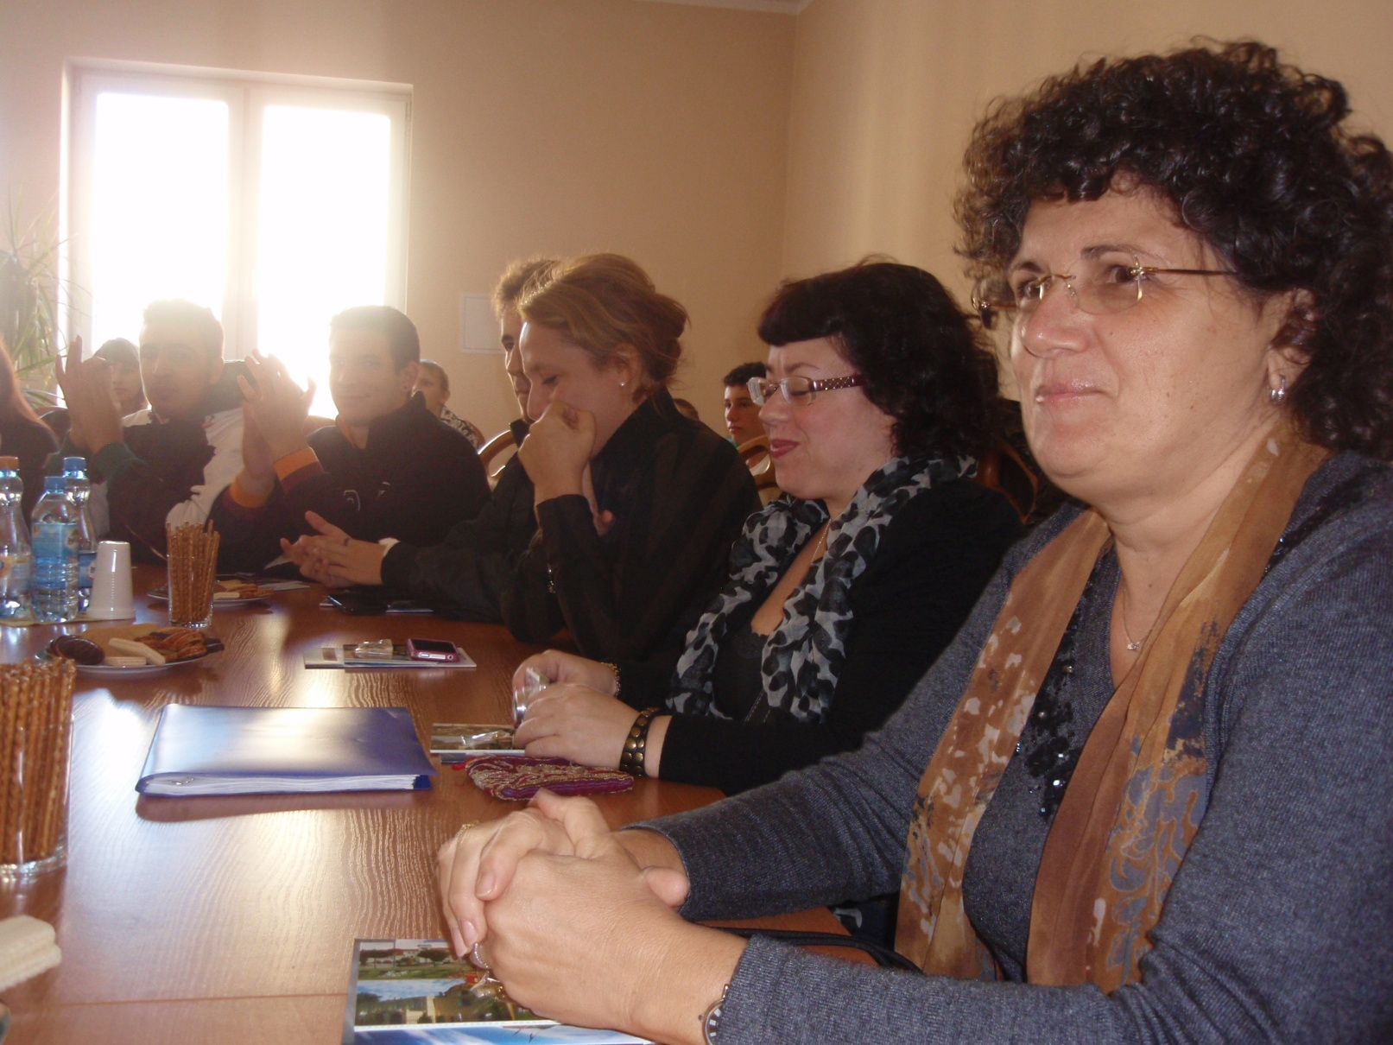
Poland, Labishin, October 2012 The Italian friends at the meeting

Slide 19
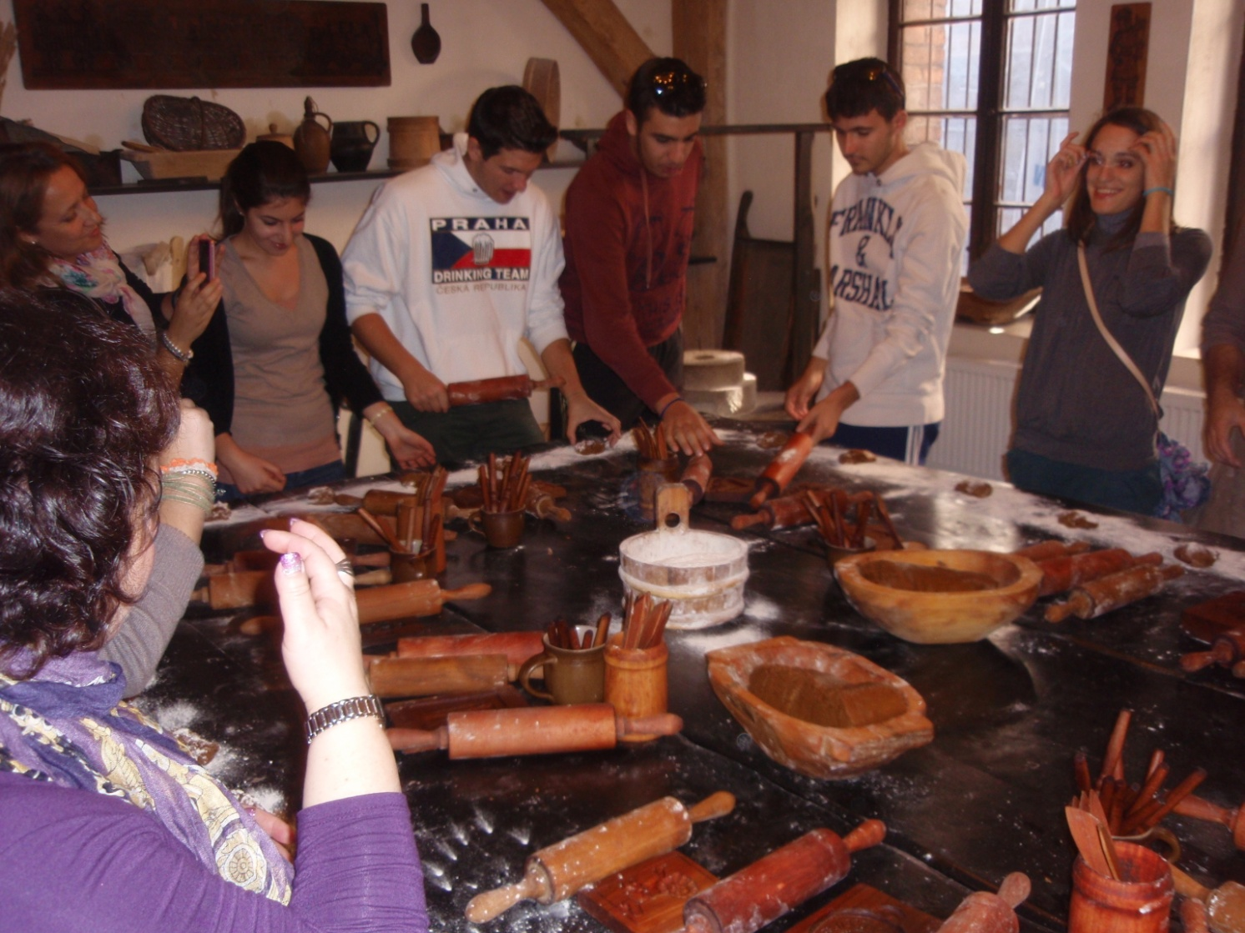
Poland, Toruň, October 2012 National heritage – ginger bread making, also funny

Slide 20
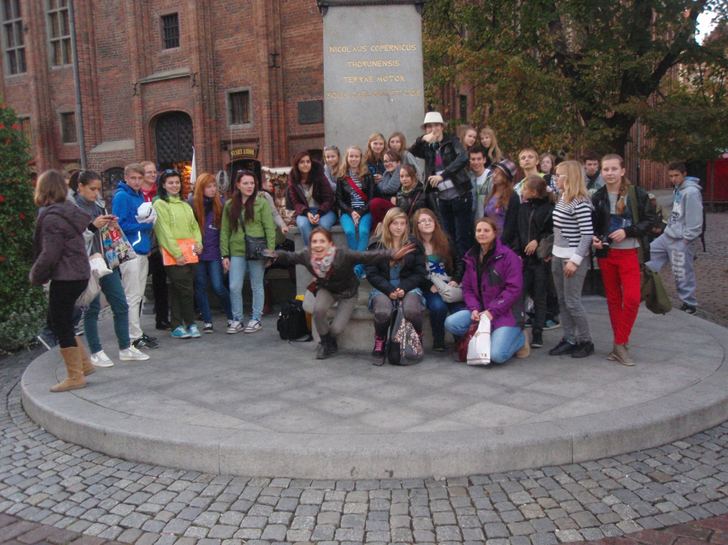
Poland, Toruň, October 2012 After searching for jokes

Slide 21
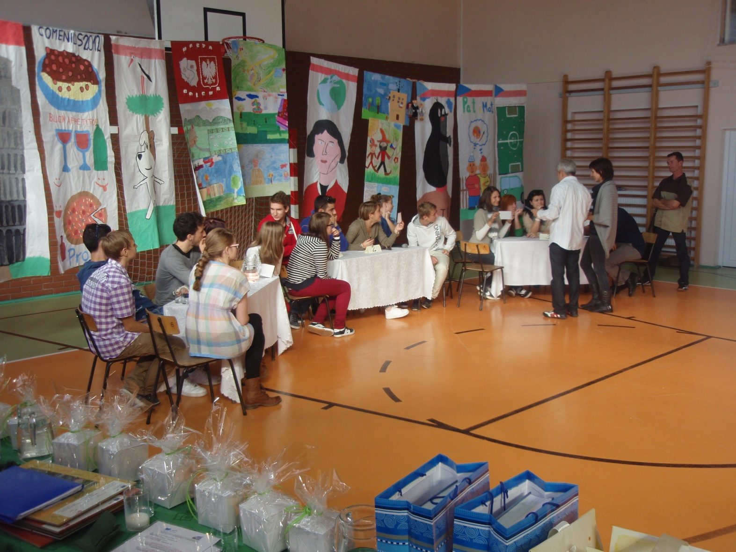
Poland, the school in Lubostroň, October 2012 Funny figures and quizing students

Slide 22
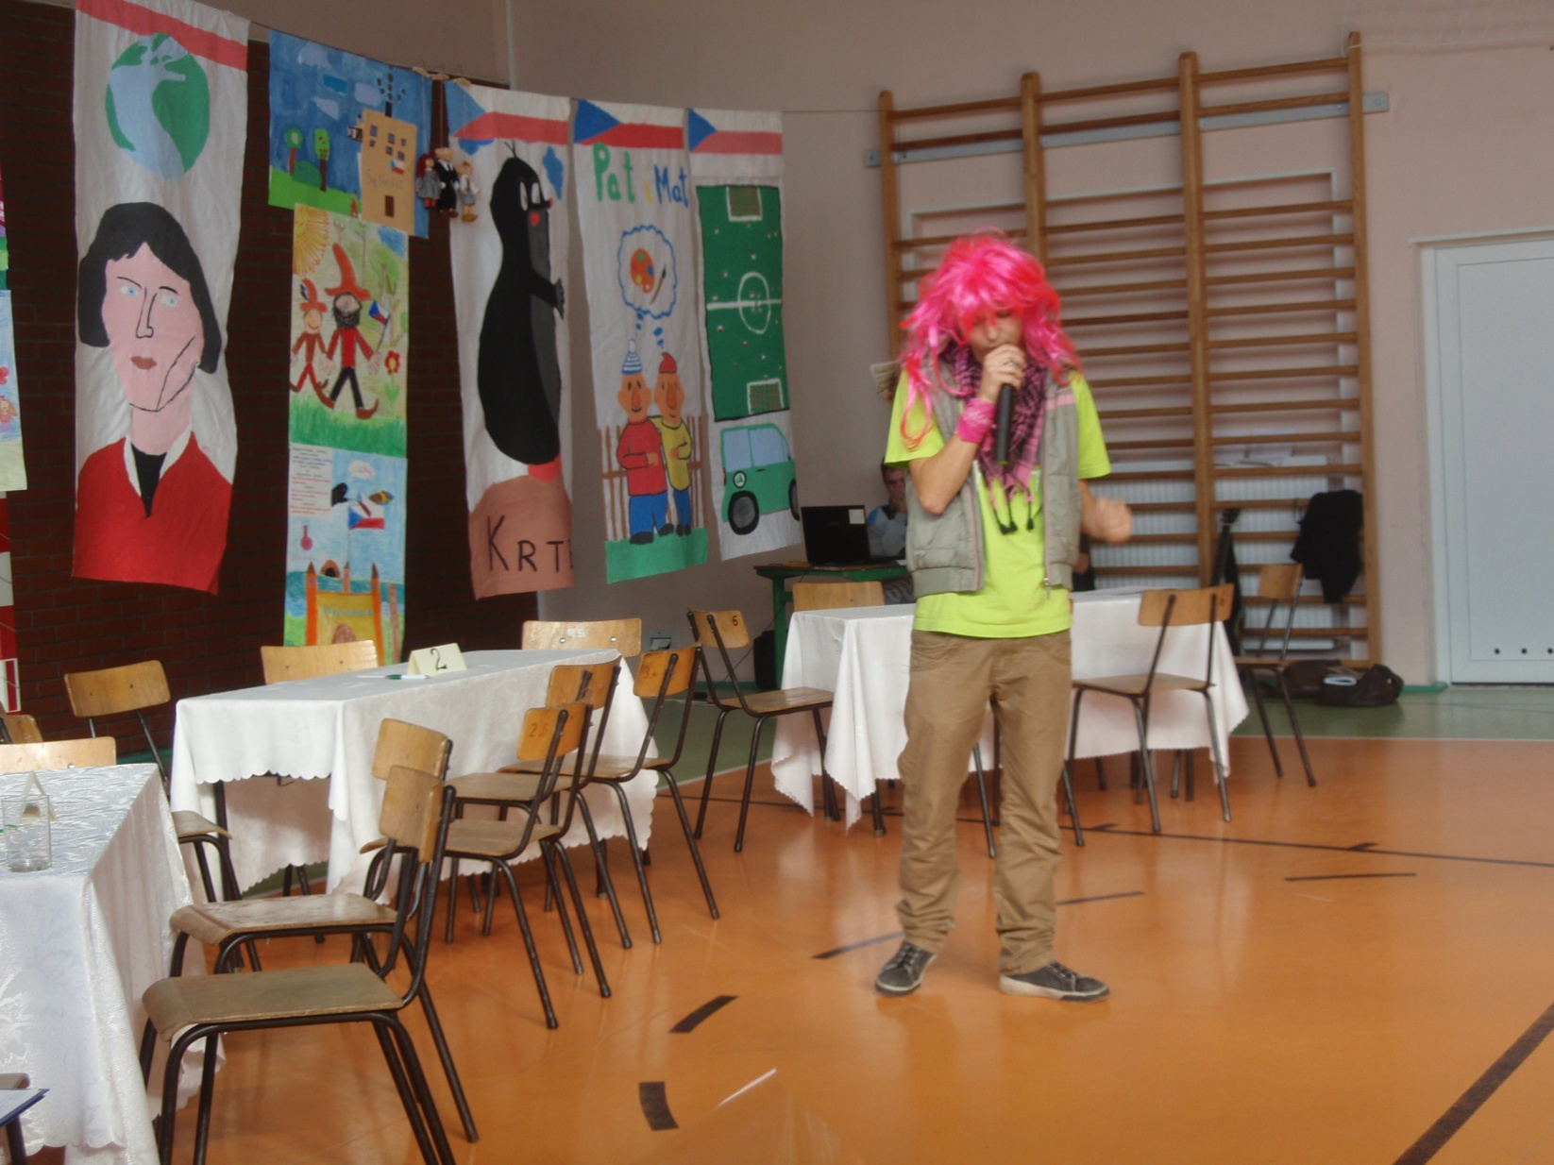
Poland, the school in Lubostroň, October 2012 Jokes telling

Slide 23
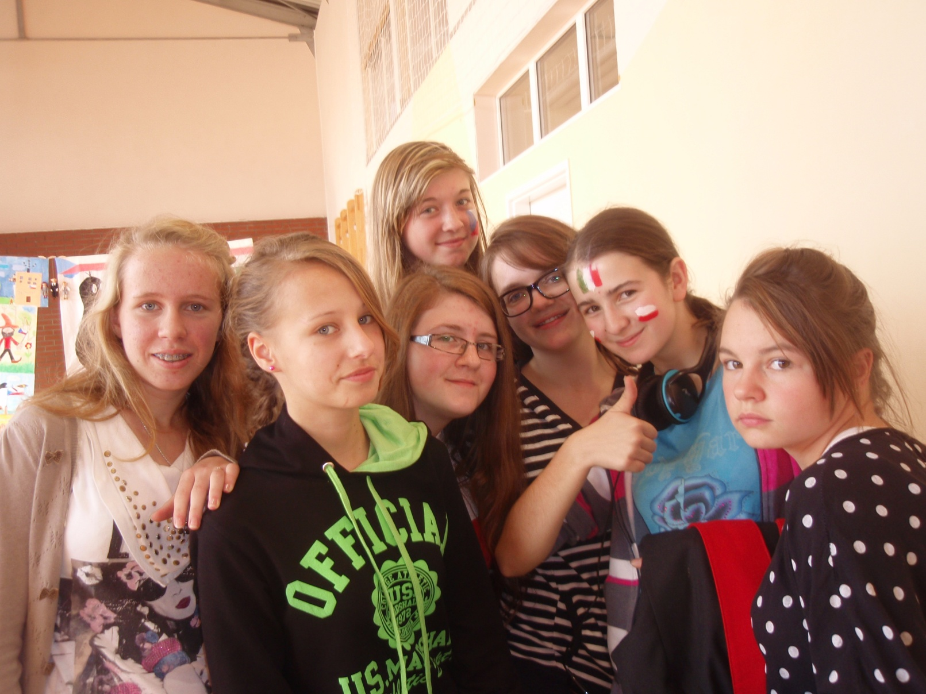
Poland, the school in Lubostroň, October 2012 Funny girls ☺

Slide 24
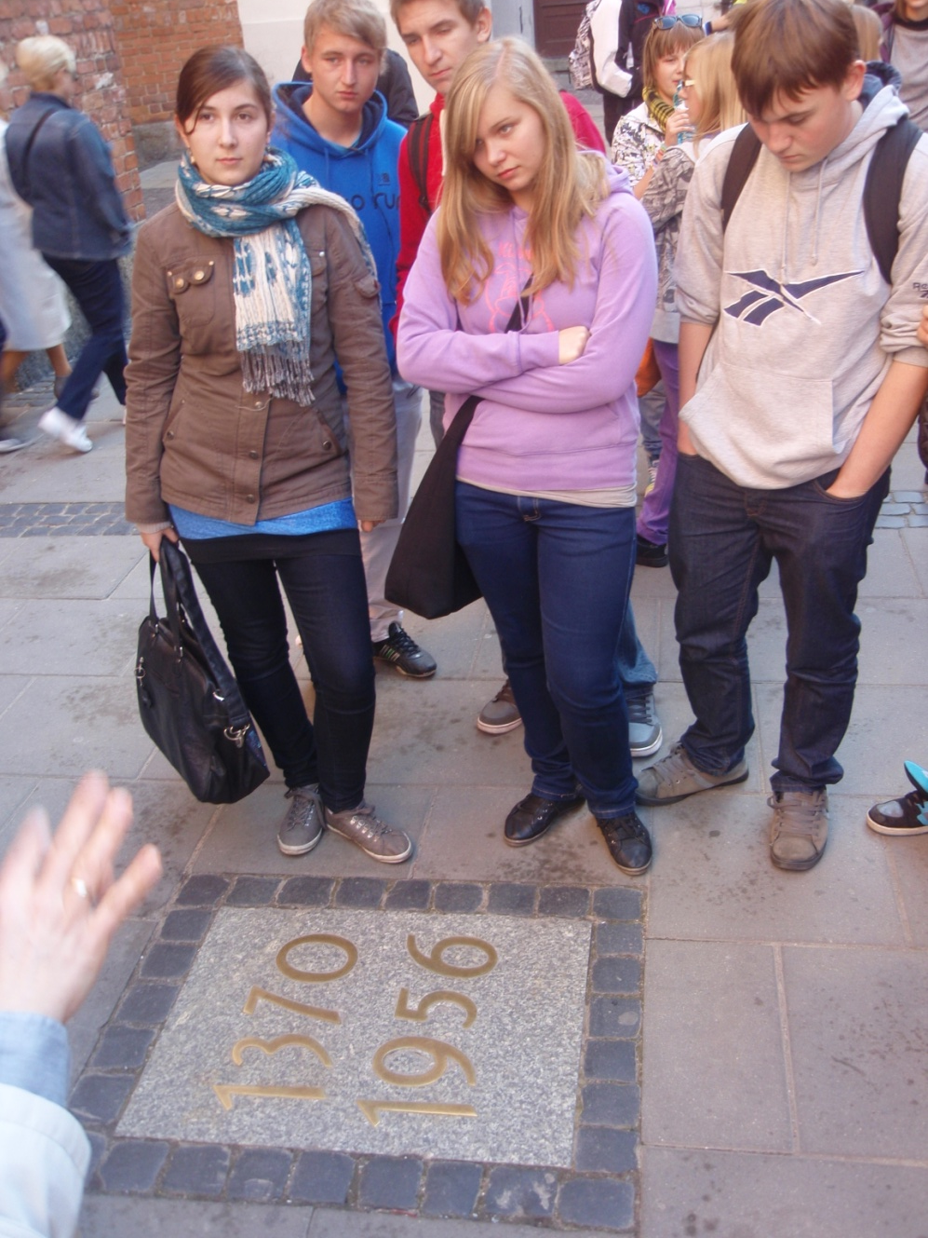
Poland, Warszawa, October 2012
Not always fun
at the cathedral of St. John the Baptist in Warszawa damaged in, and rebuilt after the WWII.

Slide 25
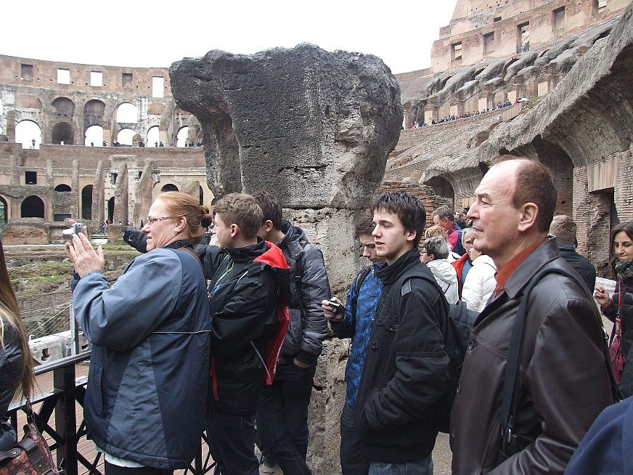
Italy, Rome, March 2013, national heritage – the Coloseum

Slide 26
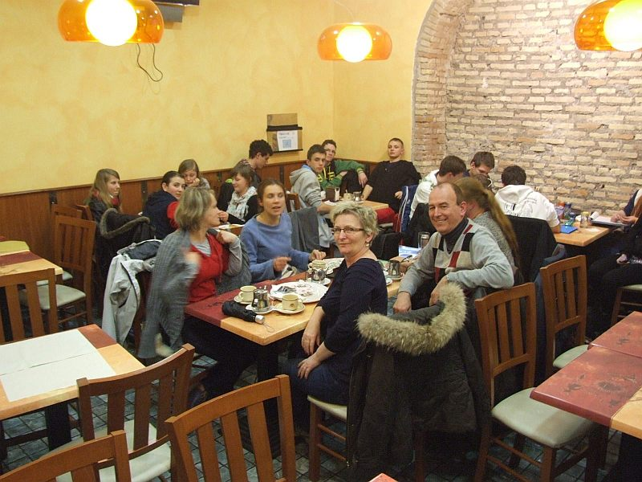
Italy, Rome, March 2013, a rest and exchanging jokes

Slide 27
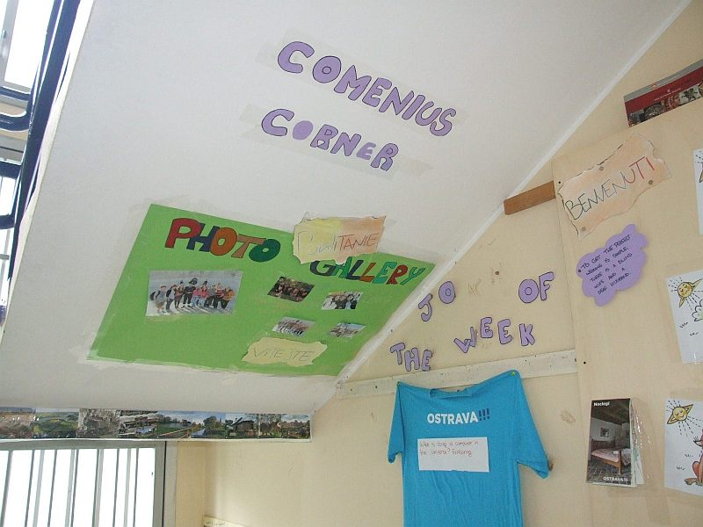
Italy, Sezze, March 2013, The Comenius corner in the school in Sezze

Slide 28
Italy, Sezze, March 2013, One of the jokes presented

Slide 29
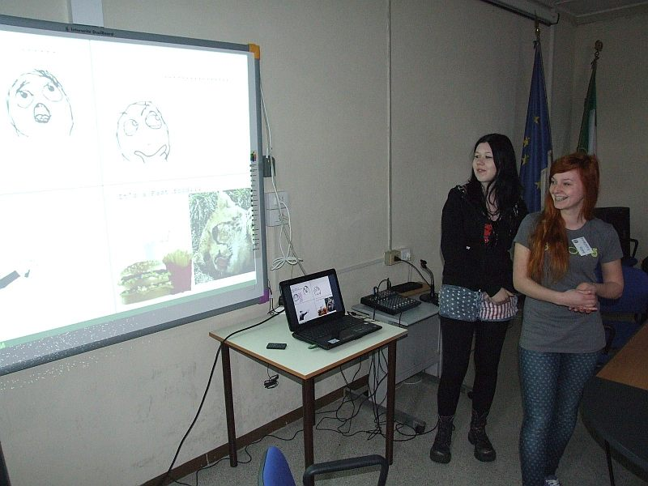
Italy, Sezze, March 2013, Yes, it is funny

Slide 30
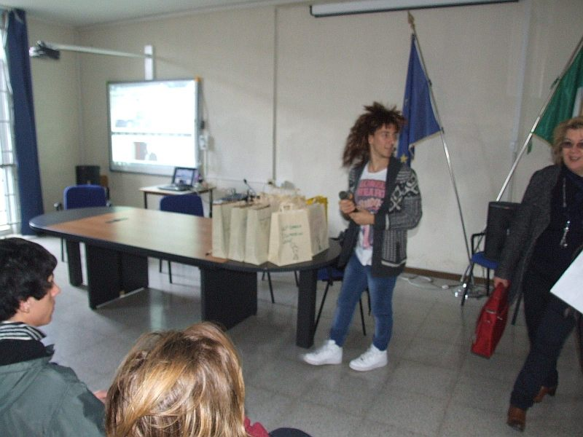
Italy, Sezze, March 2013, Dramatization

Slide 31
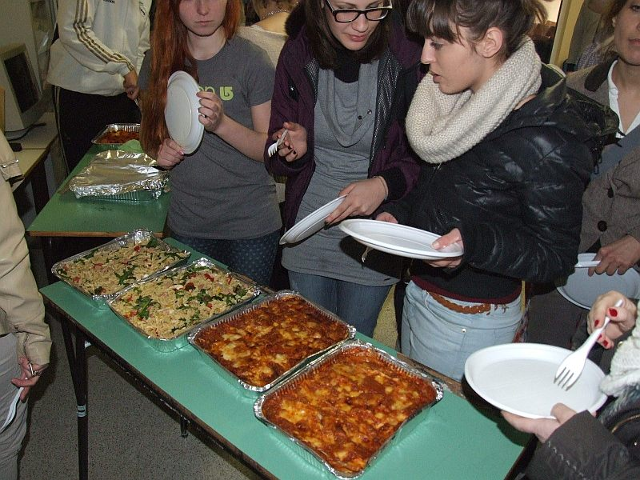
Italy, Sezze, March 2013, Getting some more energy for some more fun

Slide 32
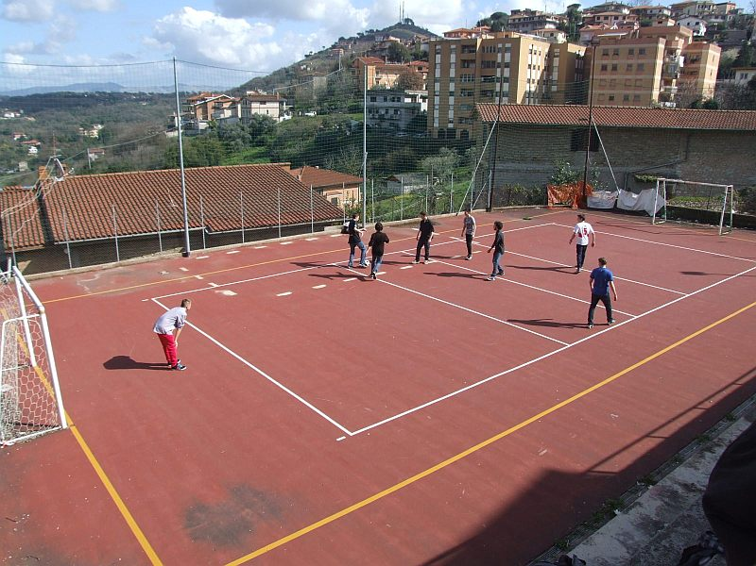
Italy, Sezze, March 2013, Multinational football match

Slide 33
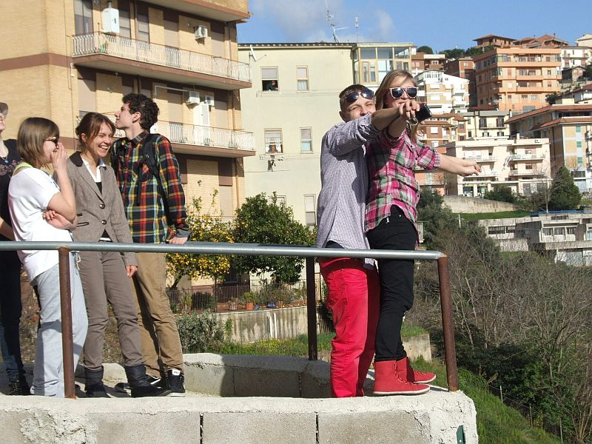
Italy, Sezze, March 2013, Kate Winslet and Leonardo di Caprio

Slide 34
I‘ll make you laugh
Incorporation OF jokes in the lessons:
Warm ups, getting points or even marks if a joke presentation is extraordinary.
Translation exercises, CZ – E, E – CZ.
Dramatization – sketches on the base of jokes

Slide 35
I‘ll make you laugh
On-going evaluation:
An excellent opportunity to get together and talk in English.
Students engaged like the project, established individual contacts, even not regarding just jokes.

Slide 36
I‘ll make you laugh
HAVE
A GREAT
FUN

